Slide 1
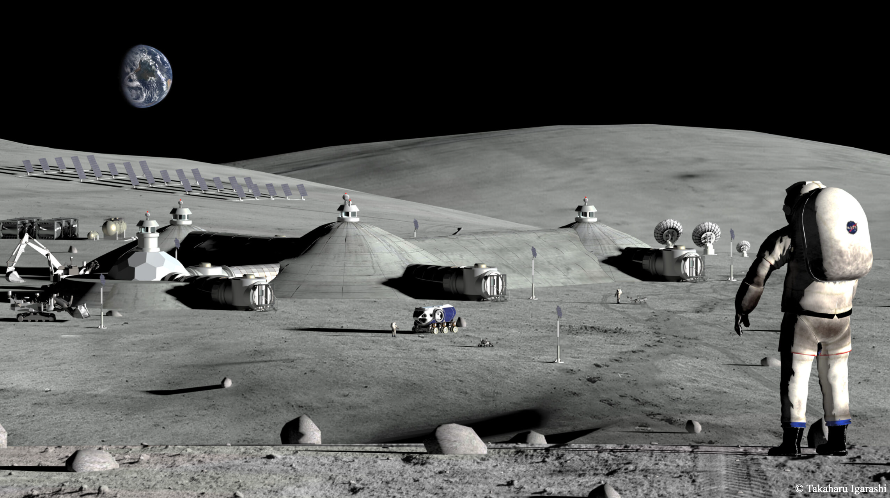
Modeling and Mitigating Lunar Habitat Disruptions
~Aaryan Lath
Notes:
Imagine climbing the summit of the Himalayas without having any knowledge of the conditions, thinking it is a regular camping trip. The lack of oxygen, snow avalanches, potential frostbites all while having a lack of proper base camp supplies sure is a recipe for disaster. Thus, having some knowledge about what one can expect is important and same is the case for setting up a permanent settlement on the lunar surface. Good morning, I am Aaryan Lath and I am part of the resilience thrust in Resilient Extraterrestrial Habitat Institute under Prof. Karen Marais.

Slide 2

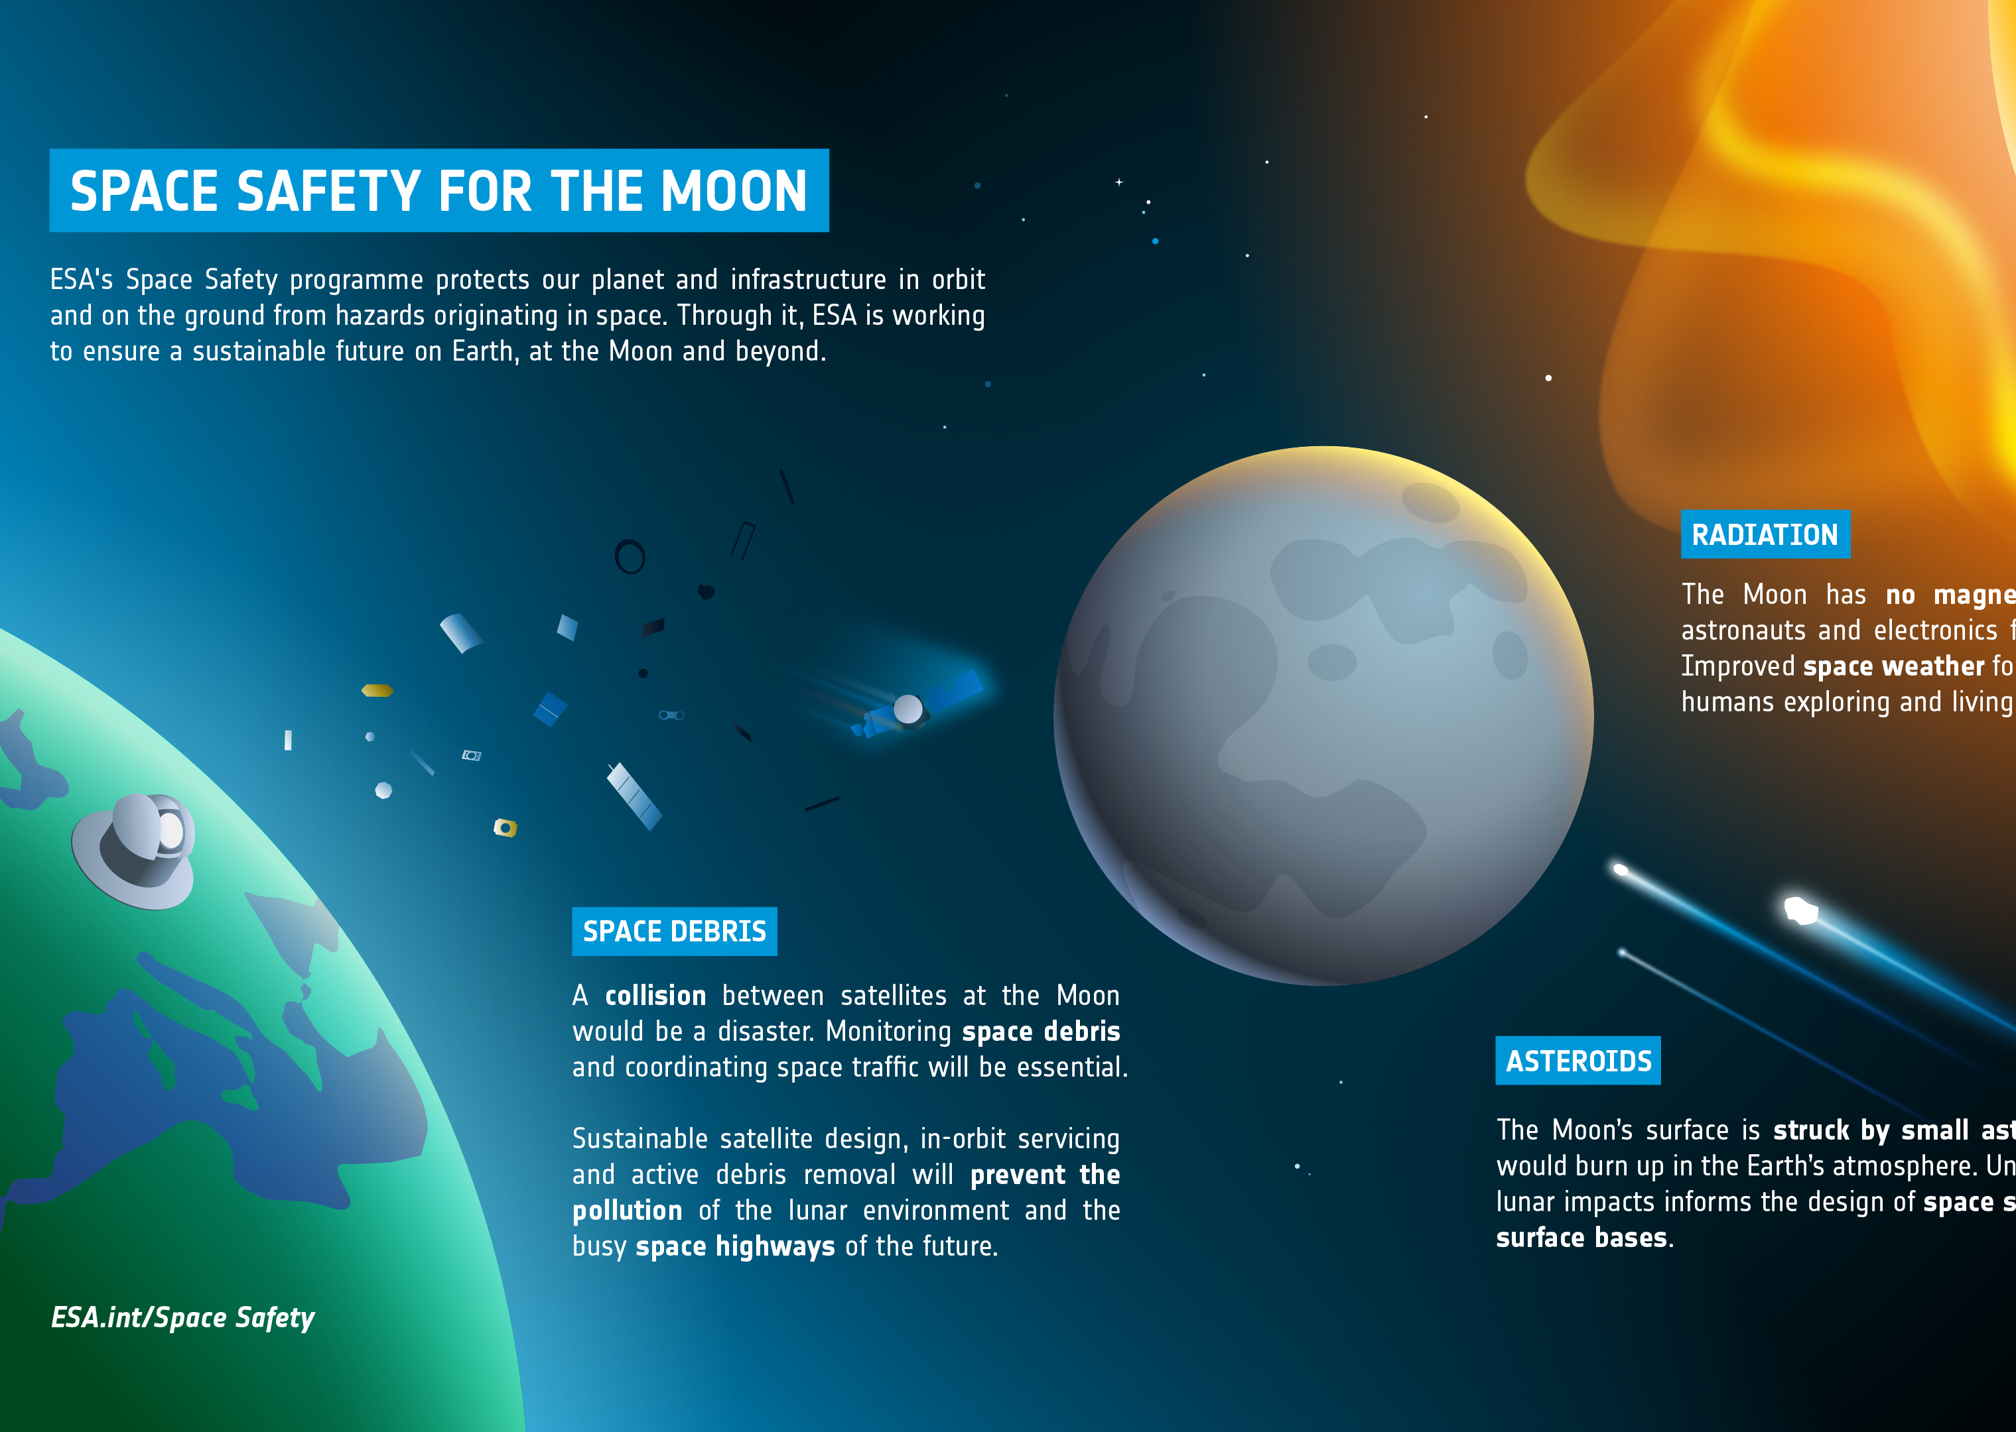
Motivation
Sustained lunar presence
Severe conditions
Notes:
Why is it important to learn about the conditions on the moon, well, NASA’s Artemis program aims to maintain a sustained presence on the lunar surface and it is imperative to know about the potential threats posed to the habitats and it’s crew. The severe environment or the lack of it, leads to an incredible temperature fluctuation on the surface from 394 Kelvin during the day to 140 Kelvin during the night. Thus, it is important to prepare for these known phenomena and unknown phenomena and make the habitat resilient.

Slide 3
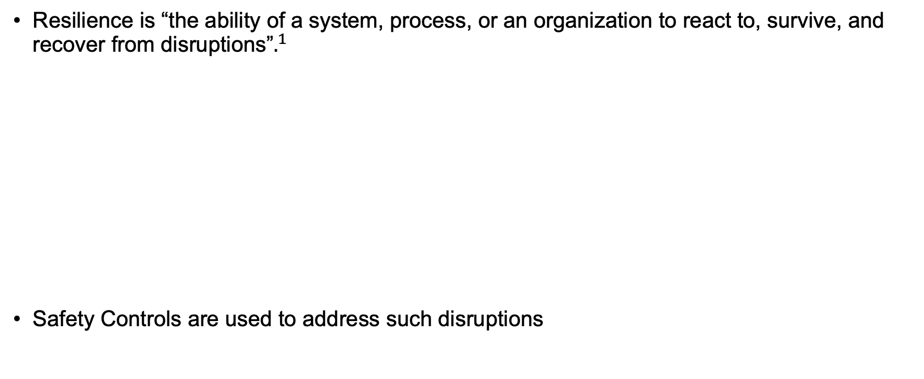

Resilience
Causes of Disruptions
Resilience is “the ability of a system, process, or an organization to react to, survive, and recover from disruptions”$.^{1}$
Safety Controls are used to address such disruptions
${}^{1}$ Uday and Marais, 2016
Notes:
Resilience is “the ability of a system, process, or an organization to react to, survive, and recover from disruptions”.
Now, one might ask, but what are disruptions? → Disruptions can significantly affect habitat systems and overall functionality which can be caused by human errors, equipment failures or environmental hazards. The measures used to address disruptions are called safety controls.

Slide 4
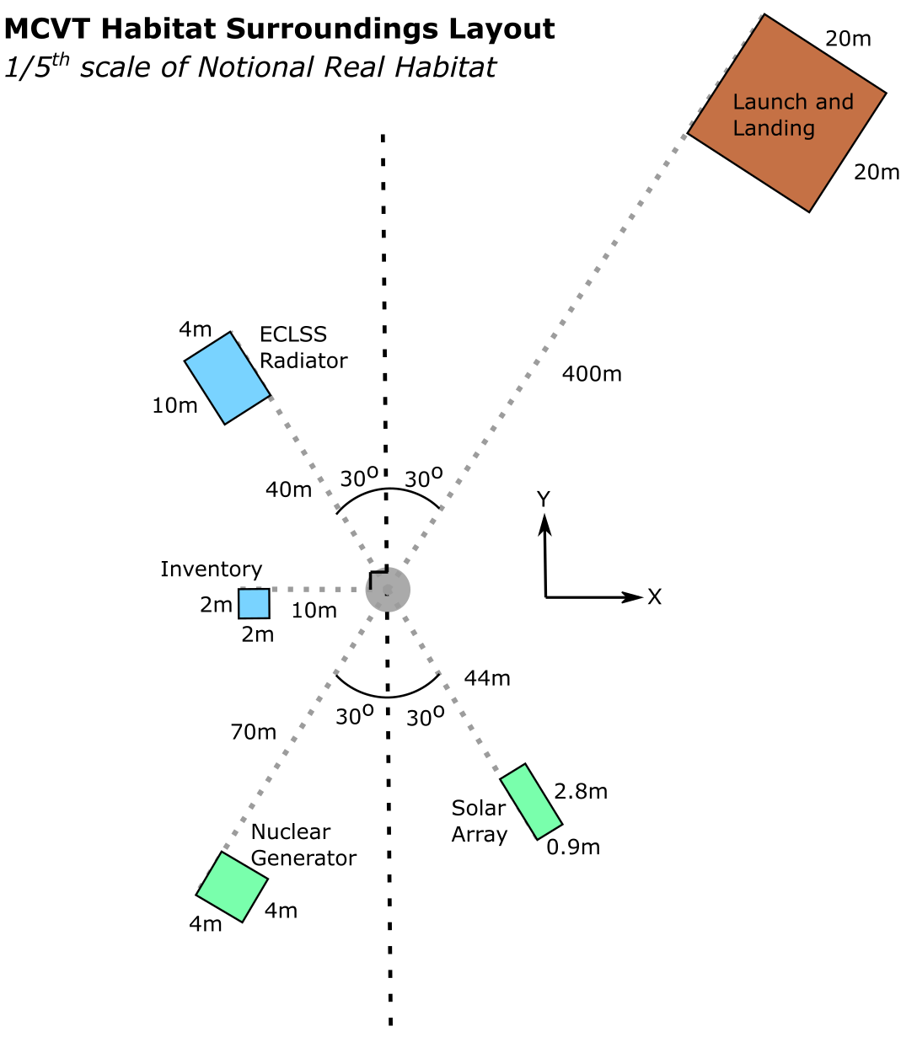
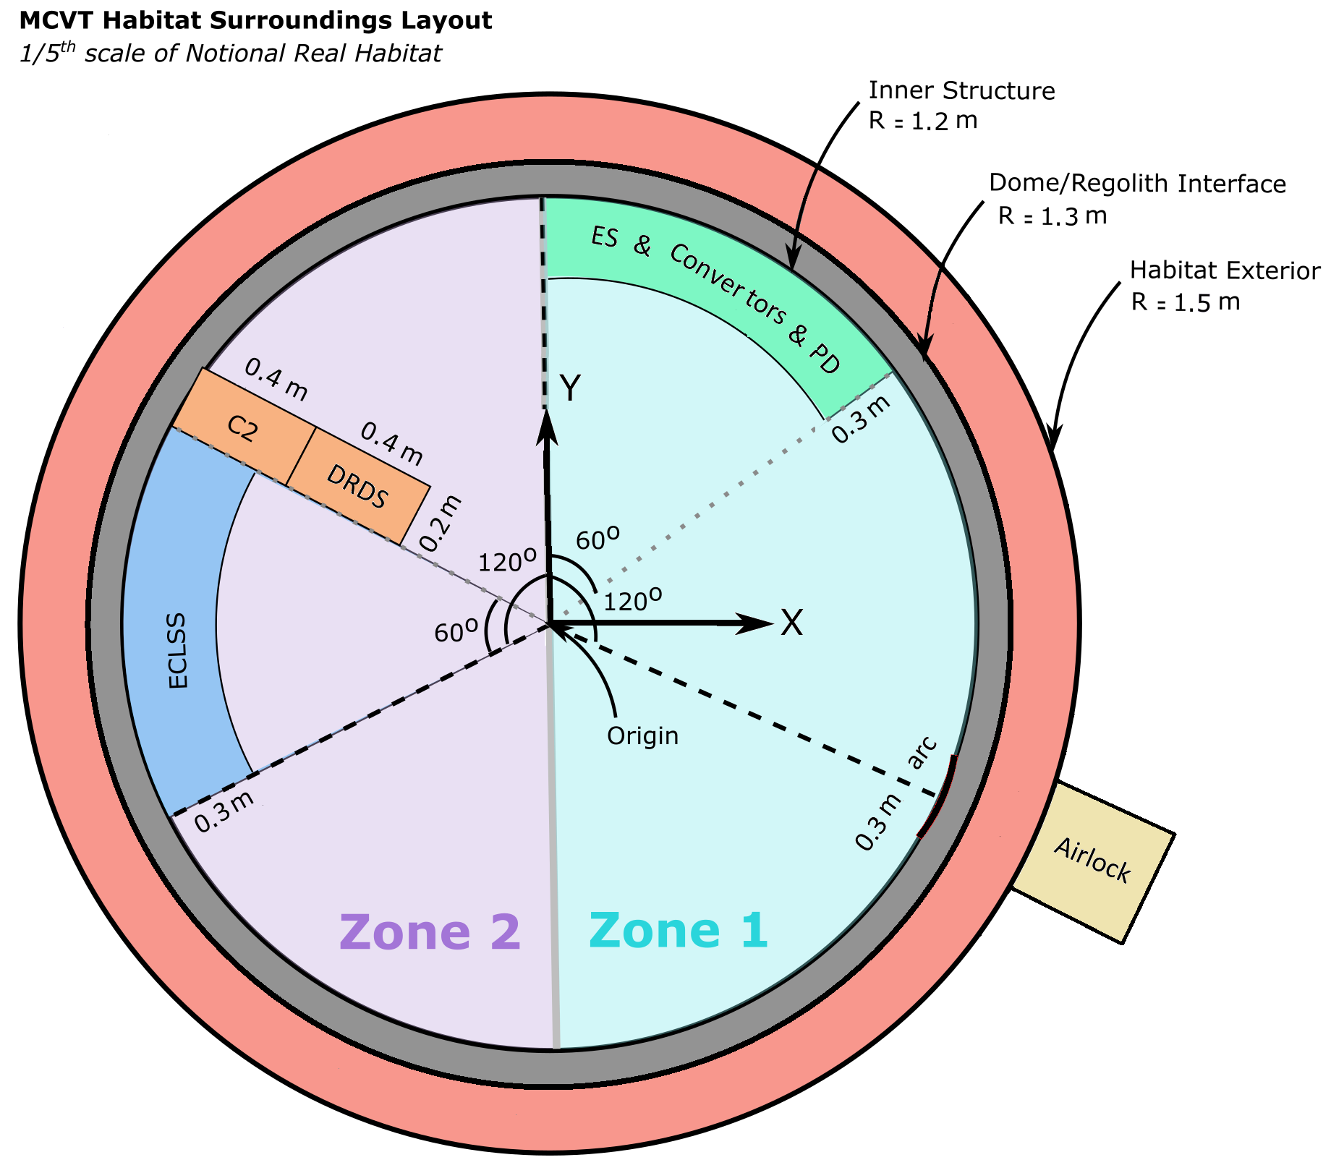
Reference Habitat
Notes:
This is the reference habitat that I am analyzing here at RETHi. Now, imagine you are performing an experiment in the habitat requiring a lot of power. While working in another zone of the habitat performing the experiment, a wiring near the Environmental Control and Life Support System suddenly catches fire.
What are the events following the ignition of the fire?

Slide 5
Disruption Scenario
Fire near Environmental Control and Life Support System
Impact on system
Impact on subsystem
Fire near ECLSS
Impact on Agent
Impact on Habitat
Fire in Habitat
ECLSS on Fire
Increased levels of CO2
IE temperature and pressure Increase
Condenser
deformation
Compressor degradation
Evaporator
deformation
Heater degradation
Fan degradation
Comp & Fan efficiency is impacted
ST temperature increase
Humidity control system performance decreased
Sabatier system performance decreased
IE Temperature Drop
Habitat oxygen generator performance decreased
ECLSS compensation
SPL temperature increase
More power demand
Limited water supply
Energy may be drawn from storage
Reduced power supply to non-essential systems
There may be a power shortage
Deviation from Scientific Mission
IE not suitable for crew
Notes:
This diagram highlights the effects of the fire near the ECLSS and the cascading effects on the habitat

Slide 6
Safety Controls
Mitigating fire near ECLSS
Notes:
Effective safety controls contribute to resilience by ensuring that systems can withstand disruptions without catastrophic consequences. The safety controls that will be identified here to extinguish the fire are an automatic sprinkler system, using a fire blanket and using a fire extinguisher.

Slide 7
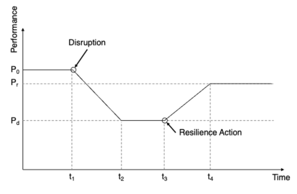

Evaluating Safety Controls
Which set of safety controls will maximize resilience for a given cost?
Use Control Effectiveness to gauge the resilience of the safety control
Use Equivalent System Mass as a method of assessing cost
Notes:
Effective safety controls contribute to resilience by ensuring that systems can withstand disruptions without catastrophic consequences. The safety controls that will be identified here to extinguish the fire are an automatic sprinkler system, using a fire blanket and using a fire extinguisher.

Slide 8
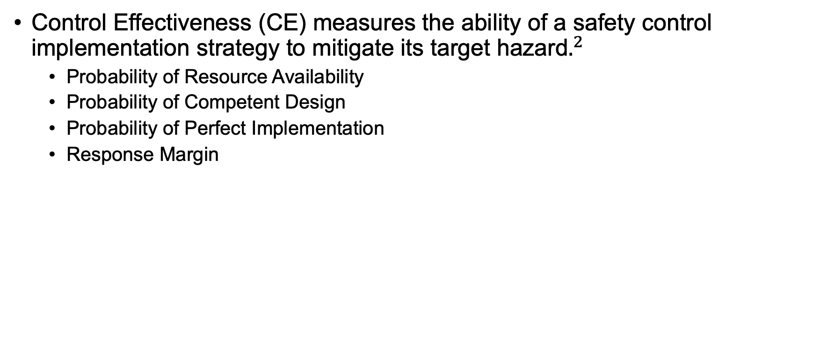

Control Effectiveness
Control Effectiveness (CE) measures the ability of a safety control implementation strategy to mitigate its target hazard$.^{2}$
Probability of Resource Availability
Probability of Competent Design
Probability of Perfect Implementation
Response Margin
${}^{2}$ Jain et al, 2024
Notes:
Effective safety controls contribute to resilience by ensuring that systems can withstand disruptions without catastrophic consequences. The safety controls that will be identified here to extinguish the fire are an automatic sprinkler system, using a fire blanket and using a fire extinguisher.

Slide 9
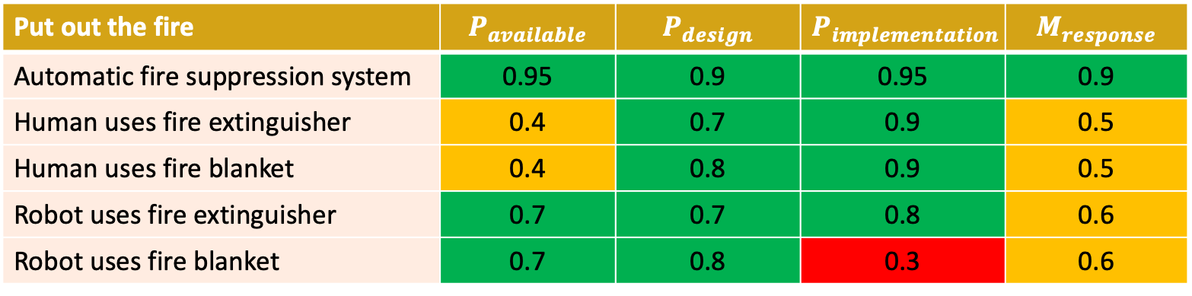
Control Effectiveness Evaluation
Put out the fire | $$P_{available}$$ | $$P_{design}$$ | $$P_{implementation}$$ | $$M_{response}$$
Automatic fire suppression system | 0.95 | 0.9 | 0.95 | 0.9
Human uses fire extinguisher | 0.4 | 0.7 | 0.9 | 0.5
Human uses fire blanket | 0.4 | 0.8 | 0.9 | 0.5
Robot uses fire extinguisher | 0.7 | 0.7 | 0.8 | 0.6
Robot uses fire blanket | 0.7 | 0.8 | 0.3 | 0.6
Notes:
Due to time constraints, I won’t be going into the detail on how each and every value has been assigned. So, just to highlight a few, the automatic fire suppression system as seen has the highest probabilities since it is readily available unlike humans and robots, the implementation is straightforward where it should be sensor activated and the response will be a lot quicker. Based on the table, it is clear that one should use an automatic fire suppression system, although, is there a trade-off to take into account?

Slide 10
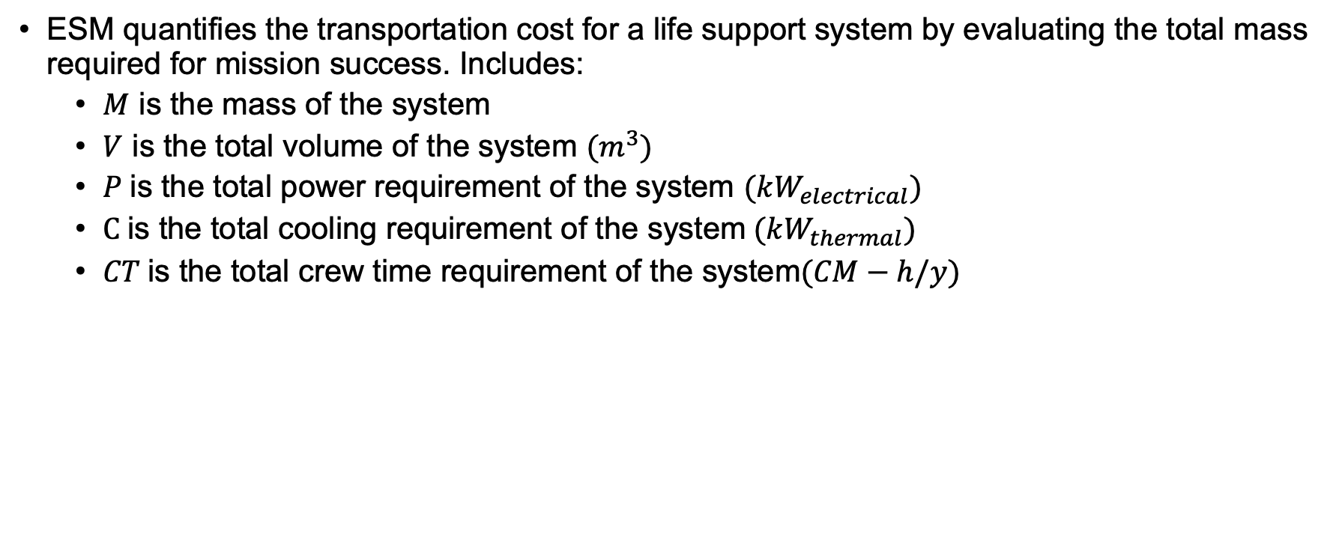
Equivalent System Mass (ESM)
ESM quantifies the transportation cost for a life support system by evaluating the total mass required for mission success. Includes:
$M$ is the mass of the system
$V$ is the total volume of the system ${(m}^{3})$
$P$is the total power requirement of the system $(kW_{electrical})$
$C$is the total cooling requirement of the system$(kW_{thermal})$
$CT$is the total crew time requirement of the system$(CM−h/y)$
Notes:
The trade-off is the Equivalent System mass or ESM which quantifies the transportation cost for a life support system by evaluating the total mass required for mission success. The equation above is a more simplified version of the equivalent system mass which combines mass, volume, power, and crewtime for the life support system, enabling cost-effective decision-making when comparing mission options.

Slide 11
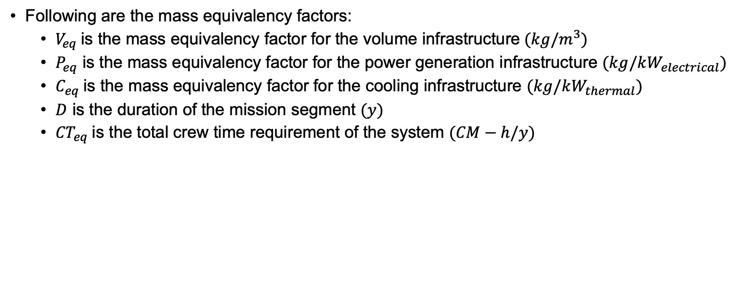
Equivalent System Mass (ESM)
Following are the mass equivalency factors:
$V_{eq}$is the mass equivalency factor for the volume infrastructure${(kg/m}^{3})$
$P_{eq}$ is the mass equivalency factor for the power generation infrastructure $(kg/kW_{electrical})$
$C_{eq}$is the mass equivalency factor for the cooling infrastructure $(kg/kW_{thermal})$
$D$ is the duration of the mission segment $(y)$
${CT}_{eq}$is the total crew time requirement of the system $(CM−h/y)$
Notes:
The mass aspect is represented by these equivalency factors.

Slide 12
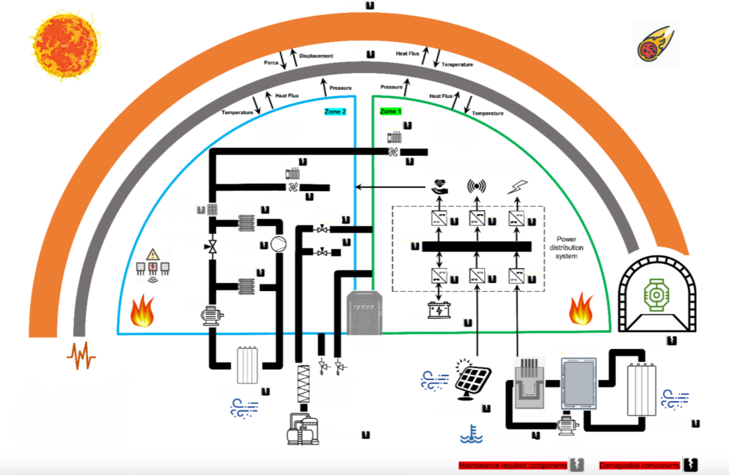
The Habitat Simulator (HabSim)
HabSim is our physics-based computational simulation environment.
Capable of simulating disruptions with systems having damageable and repairable properties (response to safety controls).
7 Disruptions
19 Triggers
217 Hazardous State
786 Safety Controls
Notes:
The HabSim allows us to simulate that reference habitat. Developed in Simulink, it is a first in many aspects. It includes capabilities to trigger both disruptions with consequences that are physics-based (e.g., micrometeorite strikes) as well as those that are represented in a phenomenological manner (e.g., fire, dust). Both classes of disruptions are designed to propagate through the System of systems and cause cascading failures. It is developed for running simulations with time durations of a couple of hours to a few days. The current version of the HabSim models 7 disruptions, about 19 triggers, 217 Hazardous States and 786 Safety controls to address the affected subsystems. The simulated habitat is a 1/5th model of a simplified lunar habitat concept developed by RETHi.
To date, we have not identified a similar simulation environment with the capability for hybrid modeling of disruptions with systems having damageable and repairable properties, parameterized agent actions, and the ability to start from various initial conditions.

Slide 13
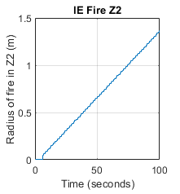
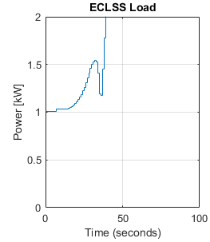
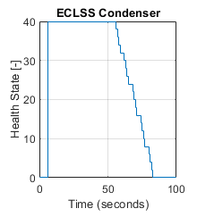
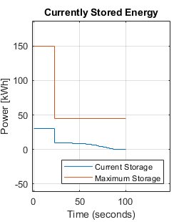
Disruption Scenario
Fire near ECLSS (Intensity Level 5)
ECLSS compensation
Condenser
deformation
There may be a power shortage

Slide 14
Future Work
Completing the trade study
Expanding the probability of availability to include the different types of inventory
Continuous
Expendable
Mixed
Generalizing the trade study to include all the disruptions
Notes:
Importance of modelling disruptions
The Control effectiveness metric as a method of improving resilience $P_{available}$, $P_{design}$, $P_{implementation}$, $M_{response}$
The Equivalent Mass System

Slide 15
Notes:
The Control effectiveness is just an initial guesstimate of the safety controls.

Slide 16

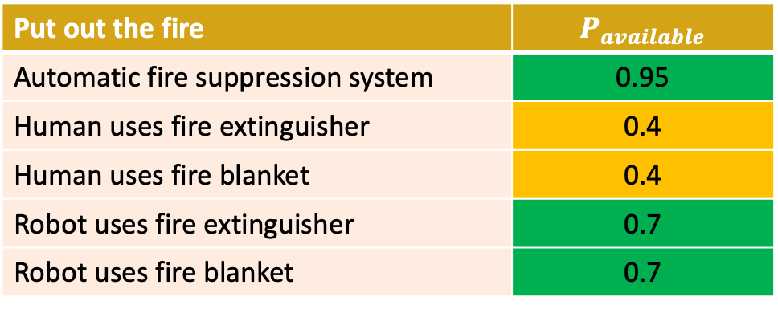
Probability of Resource Availability
This is the probability that the safety control is available when needed.
Put out the fire | $$P_{available}$$
Automatic fire suppression system | 0.95
Human uses fire extinguisher | 0.4
Human uses fire blanket | 0.4
Robot uses fire extinguisher | 0.7
Robot uses fire blanket | 0.7
Notes:
So, if the resource is not available, P_available will be 0. Again, there are passive and active safety controls, passive safety controls such as having non-flammable equipment means that P_available is 1. For the case of a fire on the floor, the automatic fire suppression system will have a P_available of 0.95 since it is throughout the habitat and will be close to the fire when the fire is detected. For the case of the availability of humans, they are less likely to be available than robots since they might be engaged in other tasks hence their P_available will be 0.4 and 0.7 respectively.

Slide 17

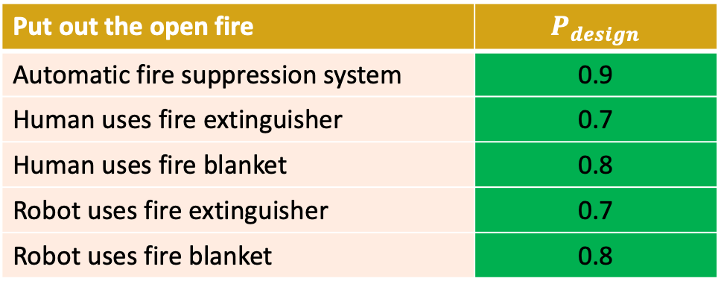
Probability of Competent Design
This is the probability that the safety control if implemented perfectly, will address its target hazard.
Put out the open fire | $$P_{design}$$
Automatic fire suppression system | 0.9
Human uses fire extinguisher | 0.7
Human uses fire blanket | 0.8
Robot uses fire extinguisher | 0.7
Robot uses fire blanket | 0.8
Notes:
This is the probability that the safety control, if implemented perfectly, will address its target hazard and the damage caused by it.
In the case of a fire hazard, the fire extinguishers will be a better option as opposed to the fire blanket when battling corner fires whereas, the fire blankets will be more suitable for open fires.
In this example, let us focus on open fires, hence, the probabilities assigned to the 3 scenarios are:

Slide 18

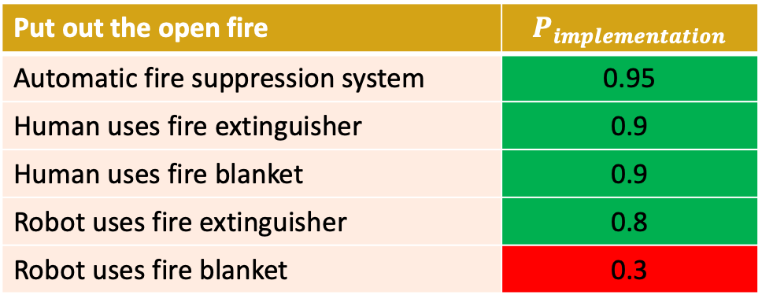
Probability of Perfect Implementation
This is the probability that the safety control can be perfectly executed according to its design.
Put out the open fire | $$P_{implementation}$$
Automatic fire suppression system | 0.95
Human uses fire extinguisher | 0.9
Human uses fire blanket | 0.9
Robot uses fire extinguisher | 0.8
Robot uses fire blanket | 0.3
Notes:
This is the probability that the safety control can be perfectly executed according to its design to contain the disruption.

Slide 19

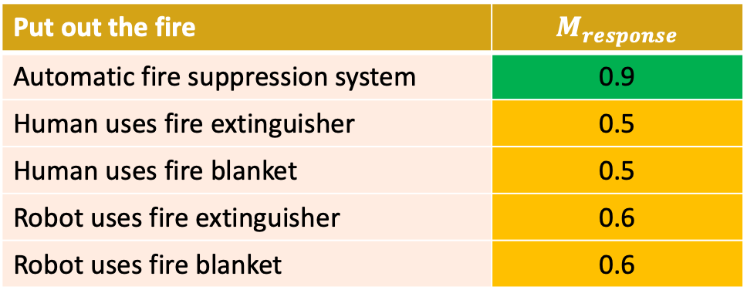
Response Margin
The time response margin captures the relationship between the time it takes for the safety control to affect the hazard, and the time for the hazard to propagate to the other systems and result in hazardous or accident states.
Put out the fire | $$M_{response}$$
Automatic fire suppression system | 0.9
Human uses fire extinguisher | 0.5
Human uses fire blanket | 0.5
Robot uses fire extinguisher | 0.6
Robot uses fire blanket | 0.6

